Slide 1
Ed-Fi Dashboard and Expert Training

Slide 2
Agenda
Part One – Dashboard Overview
Training Objectives
What are the Shelby Ed-Fi Dashboards?
Data Sources
Data Levels and User Roles
Accessing the Ed-Fi Dashboards

Slide 3
Agenda
Part Two – Expert Training
Training Objectives
The Basics of Metrics
Goal Setting
User Roles and Corresponding Claims
Footprints
General Troubleshooting
Support Page Materials
Questions and Next Steps

Slide 4
Part One – Dashboard Training

Slide 5
Agenda
Part One
Training Objectives
What are the Shelby Ed-Fi Dashboards?
Data Sources
Data Levels and User Roles
Accessing the Ed-Fi Dashboards

Slide 6
Training Objectives
By the end of this training, you will…
Understand the purpose of the Shelby Ed-Fi Dashboards
Gain a working knowledge of the Ed-Fi dashboards (including structure and data sources)
Understand various user roles and permissions
Identify ways you can use these dashboards moving forward
Notes:
The main goal of this training is that your attendees will walk away knowing the basics of the Ed-Fi Dashboards system and feeling comfortable navigating them

Slide 7
Agenda
Part One
Training Objectives
What are the Shelby Ed-Fi Dashboards?
Data Sources
Data Levels and User Roles
Accessing the Ed-Fi Dashboards

Slide 8
What are the Shelby Ed-Fi Dashboards?
The Ed-Fi Dashboards are made up of:
A longitudinal data warehouse which contains a wide range of student and teacher educational and workforce data.
Data is not changed
Data is uploaded periodically
Data is historical
Data is connected
via unique IDs
Academic Dashboards, Talent Management Dashboards, and EWS (Early Warning System) Dashboards that allow SCS staff to access educational and workforce data.
Dashboard Usage Module allow SCS staff to track usage of the dashboards.
Student
School
Teacher
District

Slide 9
What are the Shelby Ed-Fi Dashboards?
Overview of the Various Modules
Academic
Attendance
Discipline
Grades and Credits
Student Info
State Assessments
NWEA MAP
College Entrance Exams
Advanced Coursework
Transcript data
Talent Management
TEM data
TEAM data
Teacher Observations
Admin Observations
Insight and Tripod Survey data
Coaching Supports
Observation Workflow
Elevate data
Dashboard Usage
Logins
Consistency
Session Time
Uptake
Page Views
Page Actions
Admin Actions
Active Users
EWS
Risk of Not Graduating on Time
Academic Risk Factors
Attendance Risk Factors
Other Risk Factors
Intervention Status
Notes:
Talking Point:
EWS dashboards will be used for HS only
Encourage your attendees to keep the following in mind when they think about the Ed-Fi Dashboards:
The Ed-Fi Dashboards does not change the data – all data will be represented in the Ed-Fi Dashboards exactly as it comes from PowerSchool, the districts, etc. Ed-Fi aggregates it to a school and district level but does not edit or manipulate the data.
Data changed in the source data will update in the Ed-Fi Dashboards on a periodic basis. Currently it is updated either on a daily (attendance, discipline, student/parent info) basis or a weekly basis (everything else).
Historical data is stored in the Ed-Fi Data Warehouse. The span depends on each data component and availability. Most are from the 14-15 to current school year
All of the data sources are linked within the data warehouse via unique IDs (i.e. state IDs, school IDs, etc.)

Slide 10
What are the Shelby Ed-Fi Dashboards?
ACCESS
EASE
The Ed-Fi Dashboards provide access to historical, timely, and predictive information on Shelby County's students
The Dashboards that are easy to view and navigate
LINKS
The Ed-Fi Data Warehouse and Dashboards enable the linking of disparate data sources
MULTI-DIMENSIONAL
Provides Shelby staff with a multidimensional, holistic picture of student achievement & talent management.
Notes:
Review these four key characteristics of the Ed-Fi Dashboards with your attendees.

Slide 11
Things to Keep in Mind
The Ed-Fi Dashboards were built to help users view a broader range of data in more actionable ways than was previously possible.
There is no “magic” to the data. Ed-Fi Dashboards reflect data exactly as it is loaded into the data sources by districts and schools.
There are many ways to use the Ed-Fi Dashboards. Find the ones that are most helpful to you.
Ed-Fi Dashboards will be launched district-wide in Fall 2016. We want your help to determine what might be improved before then!

Slide 12
Things to Keep in Mind
SCS Board Policy 6003 (Confidential Student Information) applies to Ed-Fi:
Staff should NEVER share usernames or passwords for SCS administrative systems with others.
Staff should NEVER leave a computer screen up that contains confidential student information.
Staff should ALWAYS log out when not using the system.
Staff should ALWAYS secure any printouts of confidential student information.
Staff should ONLY use the information appropriately and in the manner required for the performance of their employment duties.
Notes:
Remind the training participants that, like all student and staff data, the data in the Ed-Fi dashboards is confidential. Extra care should be taken to ensure that access to this data is always secure.

Slide 13
Agenda
Part One
Training Objectives
What are the Shelby Ed-Fi Dashboards?
Data Sources
Data Levels and User Roles
Accessing the Ed-Fi Dashboards

Slide 14
Shelby Ed-Fi Data Sources
Zoho
State Assessment
PowerSchool SMS
SHELBY DASHBOARDS
ACT and College Entrance Exams
APECS
MyLearningPlan
Notes:
This is a broad view of the data sources that feed into Shelby Ed-Fi Dashboards.
Academic Dashboard Sources
PowerSchool, ACT/SAT reports, TCAP
Talent Management Sources: When the Talent Management dashboards become available, they will be populated with data from MyLearningPlanDepartment of Employment and Workforce provides employment and wage data
Remember – DATA IN → DATA OUT
The data in the Ed-Fi Dashboards is populated from school-level data sources. If there are errors in the source data, then there will be errors in the Dashboards.
facilitators should stress that each school will be responsible for cleaning up their data as much as possible and the Ed-Fi expert should work with the SMS administrator or other system admins as data quality issues arise.

Slide 15
Agenda
Part One
Training Objectives
What are the Shelby Ed-Fi Dashboards?
Data Sources
Data Levels and User Roles
Accessing the Ed-Fi Dashboards

Slide 16
Shelby Ed-Fi Dashboards Data Levels
Data in is aggregated in the Ed-Fi Dashboards at three main levels:
Various user roles provide access to these levels based on the permissions of the role (see the section on “User Roles” for additional information).
District
School
Student
Notes:
Review the three levels that data is aggregated in Shelby Ed-Fi Dashboards.

Slide 17
User Roles: Who Can Access Shelby Ed-Fi Dashboards?
Ed-Fi Dashboards can be accessed by individuals in the following categories:
Level | User Role | Role Description
DISTRICT | District Administrator
 | ILD
 | District Staff
SCHOOL | Principal
 | Assistant Principal
 | Counselor
 | Coach
 | Teacher
 | Supporting Staff
District
School
Teacher
Student
District
School
Teacher
Student
District
School
District
School
Teacher
Student
District
School
Teacher
Student
District
School
Student
District
School
Student
District
School
Teacher
Student
District
School
Dotted lines indicate where user access is limited to the specific district/school/students to which they have been linked.
Notes:
The user roles are divided into two main levels –District and School.
All roles provide access to aggregate data at the district and school levels.
District Administrators will only have access to Teachers and Students in the schools they are associated with (i.e. ILDs)
School users (principals, counselors, and teachers) will only have access to teachers and students within their schools that they are associated with.
Teachers will only be able to see student information for students they are currently teaching
Certain confidential data (i.e. socioeconomic indicators) will not be available to teachers or counselors, even if they have access to student data.

Slide 18
Agenda
Part One
Training Objectives
What are the Shelby Ed-Fi Dashboards?
Data Sources
Data Levels and User Roles
Accessing the Ed-Fi Dashboards

Slide 19
Exploring the Dashboards
Navigation of Dashboards
Notes:
Use Expert Navigation Guide Outline

Slide 20
Next Steps: Accessing the Ed-Fi Dashboards
You will need your SCS email address and password to log into the Ed-Fi dashboards. You MUST be on the Shelby network to access the Dashboards.
Log onto your computer.
Open an internet browser
Go to dw.scsk12.org/EdFiDashboard/
User Name: Shelby (AD) credentials
Password: Shelby (AD) credentials
Notes:
At this time, you should walk through the process for accessing the dashboards by logging into the trainees real sites. This should only be done once training in the training site is complete and all users understand access, navigation, and their role within the system.
https://dw.scsk12.org/EdFiDashboardTraining
Edfiteachhs
Te@chhs1

Slide 21
Things to Keep in Mind
School staff, particularly teachers, can use the dashboards for:
Planning for instruction and student grouping
Conducting PLCs and peer collaboration
Using during teacher-parent conferences and calls
Getting to know new students and transfers
Planning interventions for student academic, attendance, and behavior needs

Slide 22
Questions?

Slide 23
Part Two – Expert Training

Slide 24
Agenda
Part Two – Expert Training
Training Objectives
The Basics of Metrics
Goal Setting
User Roles and Corresponding Claims
Footprints
General Troubleshooting
Support Page Materials
Questions and Next Steps

Slide 25
Training Objectives
By the end of this training, you will…
Gain a functional understanding of the Ed-Fi Dashboards
Have the knowledge to navigate the troubleshooting process and facilitate resolution
Be an expert in the user experience of the Ed-Fi Dashboards
Notes:
An Ed-Fi expert is a staff member who has been trained to serve as a resource to Ed-Fi users in a school.
They should be able to assist users in troubleshooting “Level 1” issues, and will be a liaison between end users at their school and the Help Desk team at the district.
This role will increase adoption rates immensely.

Slide 26
Agenda
Part Two – Expert Training
Training Objectives
The Basics of Metrics
Goal Setting
User Roles and Corresponding Claims
Footprints
General Troubleshooting
Support Page Materials
Questions and Next Steps

Slide 27
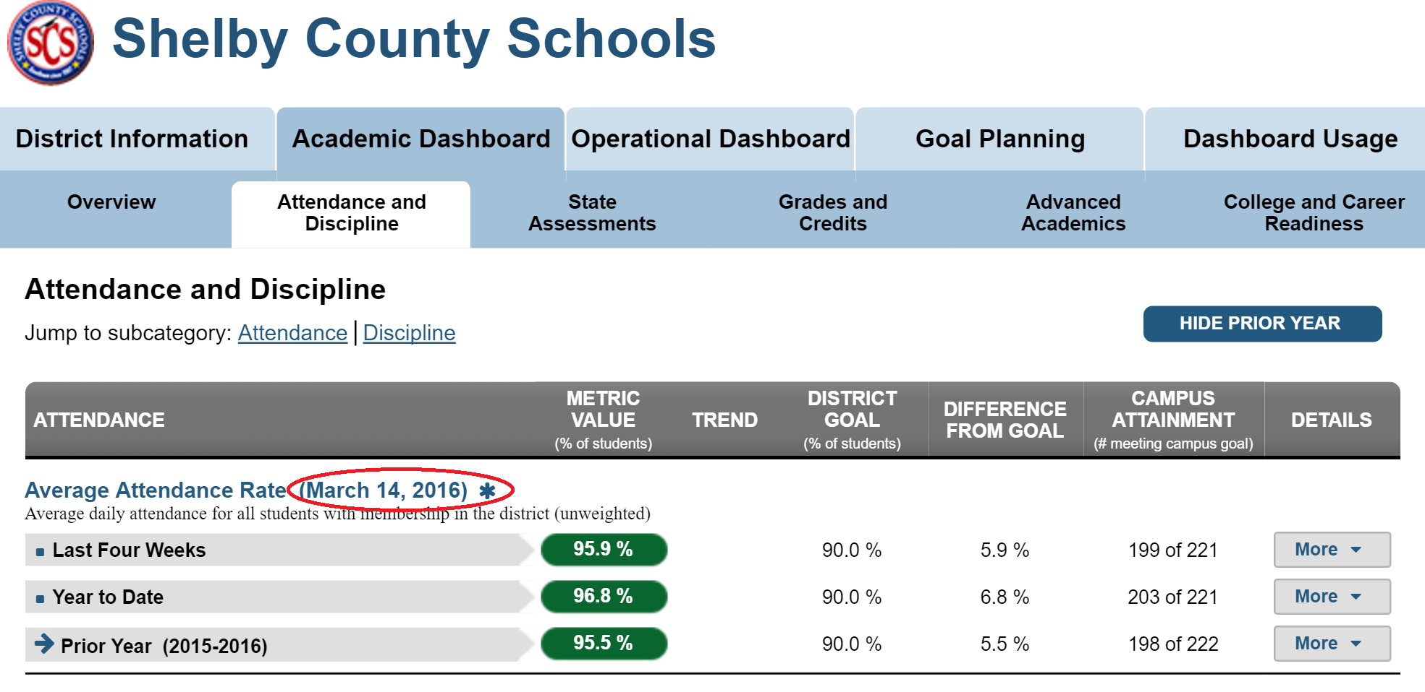
The Basics of Metrics
Key metric calculations are defined at the student, school and district level
Only currently enrolled students are included in the dashboards
Data is updated as it arrives and each metric has its own date of refresh
Users can discern the latest time the data for a particular metric was loaded by looking at the context date next to the metric:

Slide 28
Frequency of Updates
Type of Data | Update Frequency
Attendance | Nightly
Discipline | Nightly
Enrollment | Nightly
Assessments | Included in a weekly load as soon as the data files are available
Grades and Courses | Included in a weekly load as soon as the data is loaded in SMS
Credits and Transcript data | At the end of each school year
Student, Staff, and School Information | Nightly

Slide 29
Agenda
Part Two – Expert Training
Training Objectives
The Basics of Metrics
Goal Setting
User Roles and Corresponding Claims
Footprints
General Troubleshooting
Support Page Materials
Questions and Next Steps

Slide 30
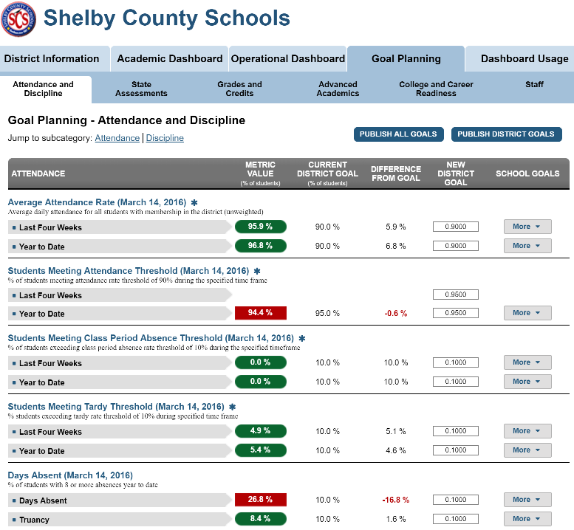
Goal Setting
You have been provided with a goal planning handout which outlines SCS’s goal setting policies for various metrics.
Goals that have been met are green ovals
Goals that have not been met are red rectangles
Notes:
Updating/changing goals in this section of the dashboard may impact the metric status (red/green) after the next build.

Slide 31
Agenda
Part Two – Expert Training
Training Objectives
The Basics of Metrics
Goal Setting
User Roles and Corresponding Claims
Footprints
General Troubleshooting
Support Page Materials
Questions and Next Steps

Slide 32
User Roles and Corresponding Claims
The following impact what a user has access to when they login to Ed-Fi:
Level of Access – this is defined by the Active Directory group assignment
School Assignments – a user will have access to schools based on assignments in SMS
Course and Students - a user will see courses and students based on assignments in SMS
Notes:
Ed-Fi dashboards have no built-in user accounts. Instead, claims are granted to users based on their role, which is passed to the Ed-fi dashboards from Shelby during the authentication process. Roles have one of two levels of access. District level roles have access granted to all schools by default. School Level roles have access granted based on schools to which users as associated in Ed-Fi.

Slide 33
Agenda
Part Two – Expert Training
Training Objectives
The Basics of Metrics
Goal Setting
User Roles and Corresponding Claims
General Troubleshooting
Footprints
Support Page Materials
Questions and Next Steps

Slide 34
General Troubleshooting
Request
Request
Users will often request a feature that already exists. If this is the case, user may need additional explanation. If it is a true feature request, request that the user submit a ticket through Footprints
Question
The user’s question may be something that was covered in dashboard training. Reference training materials on the Ed-Fi Online Resource Center www.scsk12.org/edfi
Question
Users may assume the data has a problem when in fact they need additional explanation or retraining. If this is not the case and there is a true issue with the dashboards request that the user submit a ticket through Footprints. If the user has a concern about the data appearing inaccurate or incomplete, be sure to check the original source (SMS, MLP, etc.)
Problem
Problem

Slide 35
General Troubleshooting
Common Issues Arising at Beginning of School Year
Problem | Possible Cause | Resolution
User unable to log in | Contract date has not begun User has not been added to HR and/or SIS User recently transferred to or changed roles at the school | Ensure any outdated SMS roles have been deactivated Suggest user open a Footprints ticket
Teachers or students not assigned to the correct courses | Class assignment still being updated in SIS May need to update exit and entry dates in SIS | Recommend waiting for data to stabilize (wait a few days and re-review) Review SIS for entry and exit dates (SIS Admin)
Incomplete student/parent records | Records not yet entered into SIS | Check with the school SIS Admin to determine if the records have been entered and are up to date.
Missing transcript data for transfer students/incorrect credit accumulation | Student’s data has not yet been entered into source system(s) | Review source system(s) to ensure data has been entered for that student

Slide 36
General Troubleshooting
Troubleshooting Exercises

Slide 37
Scenario 1
A teacher within your school sends you an email that states her credentials are not working and she cannot access Ed-Fi.
Notes:
Encourage participants to jot down their thoughts on how they would handle it, ask for volunteers to share out, and then display solution on the next slide.

Slide 38
Scenario 1 – Solution
1. Confirm that the user is entering the credentials correctly. This can be done through email or in-person.
2. Ensure any outdated SMS roles are deactivated.
3. Once you’ve confirmed the credentials are not working and deactivated outdated SMS roles, submit a ticket to Footprints describing the access issue.

Slide 39
Scenario 2
A user emails you and says TCAP data is displaying under the State Assessments tab and he doesn’t see his easyCBM data under the Local Assessments tab.

Slide 40
Scenario 2 – Solution
1. Inform the user that TN Ready data is not yet available in the dashboards and will be during the next administration of the test.
2. Let the user know only NWEA data is being loaded in Ed-Fi at this time but to submit a request via Footprints that you’d like easyCBM data to be considered.

Slide 41
Scenario 3
As you are walking through the hall, a school staff member says “I don’t get the purpose of Ed-Fi, what are we supposed to do with it and how am I supposed to use it?”

Slide 42
Scenario 3 – Solution
1. Ask the staff member if they’ve ever logged into Ed-Fi to determine their familiarity.
2. Mention that Ed-Fi is a tool that is meant to support users in their day-to-day work as they work with students and make decisions using student data. Encourage them to visit http://www.scsk12.org/edfi/ to learn more about the system through the quick start guides, FAQs, and other resources available to them.

Slide 43
Scenario 4
A teacher emails you to let you know something is wrong with Ed-Fi because it is showing incorrect data – her student roster is missing some students and students who are classified as special education aren’t in the dashboards.

Slide 44
Scenario 4 – Solution
1. Let the teacher know that this appears to be a data quality issue with the source data.
2. The next steps are to make sure the student assignments are correct in SMS and that students are being flagged as special education within SMS. If these are not correct in SMS, escalate the issue to the SMS administrator. If these are correct within SMS, open a ticket within Footprints.

Slide 45
Scenario 5
“I am holding a parent teacher conference in two days and I need to see a student’s discipline infractions and their old assessment scores, can Ed-Fi do this?” is asked of you by a first-year teacher.

Slide 46
Scenario 5 – Solution
1. Inform the teacher that Ed-Fi does allow for these views. Explain that a user can access a list of discipline infractions by going to the Attendance and Discipline page at a student level, going to the Discipline Referrals metric, clicking the More button, and selecting Incidents Log. Historical assessments, in addition to coursework, can be found within the Transcript tab at the student level.

Slide 47
Agenda
Part Two – Expert Training
Training Objectives
The Basics of Metrics
Goal Setting
User Roles and Corresponding Claims
General Troubleshooting
Footprints
Support Page Materials
Questions and Next Steps

Slide 48
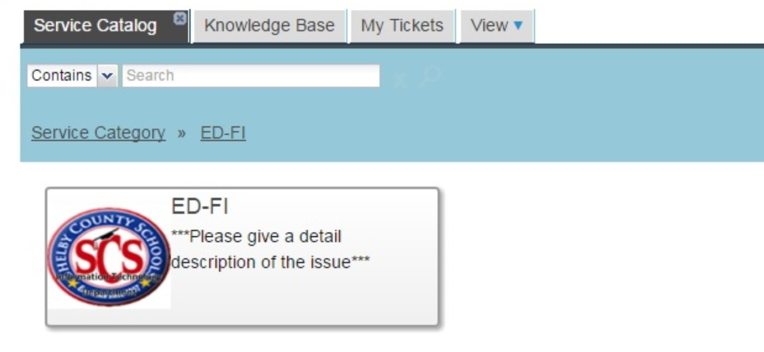
Footprints
Footprints is the SCS ticketing system for capturing Ed-Fi system issues and defects.
Submitting a ticket
Log into:
http://footprints.scsk12.org
Click on Ed-Fi

Slide 49
Footprints
2. Click on Ed-Fi again
3. Click on Service Request

Slide 50
Footprints
Submitting a ticket
The following information should be included in the ticket:
Short Description – Give some description of the issue you are experiencing.
Description – Provide detailed explanation of the issue you are experiencing. Please include your AD User ID.
Type – Please select only any of the following:
Access Issue: Location Assignment, User-Role Assignment, Other
Data Question Issue: Academic Dashboard, Early Warning System, Operations Dashboard, School Information, Student Information, Talent Management, Teacher Information, Usage Module
Enhancement/Suggestion: Suggest an Enhancement
Request for Change to Access Level: Change Request
Attach files: Please attach any screenshots of the issues you are experiencing to help us better resolve your problem.
Please save and submit the ticket

Slide 51
Agenda
Part Two – Expert Training
Training Objectives
The Basics of Metrics
Goal Setting
User Roles and Corresponding Claims
Footprints
General Troubleshooting
Support Page Materials
Questions and Next Steps

Slide 52
Support Page Materials
Ed-Fi Online Resource Center
www.scsk12.org/edfi
Developed to provide Ed-Fi users quick access to training materials, customer support portal and feedback form.
Contains end user training materials as well as trainer materials.
End user training materials
Quick start guides
Guided exercises
Frequently asked questions
Use cases
Overview and feature videos
Trainer materials
Presentation
Facilitation guide
Training site and logins
Readiness checklist
Brainstorming tool
Planning template
Feedback form

Slide 53
Planning Your Training Sessions
Review the following Train the Trainer Materials:
Training Readiness Checklist
School Based Facilitation Guide
Create an outline of next steps for planning your training sessions.
Please complete your school’s training by Friday September 30th.
Do you have any planning or facilitation questions?

Slide 54
Agenda
Part Two – Expert Training
Training Objectives
The Basics of Metrics
Goal Setting
User Roles and Corresponding Claims
Footprints
General Troubleshooting
Support Page Materials
Questions and Next Steps

Slide 55
Questions and Next Steps
Review training materials on Ed-Fi Online Resource Center
End user documents
Training documents
Follow up with your principal
Next steps for rolling out Ed-Fi in your school
Questions
Geeta Bhagat
Bhagatgs@scsk12.org
John Anderson
Andersonj5@scsk12.org

